Slide 1
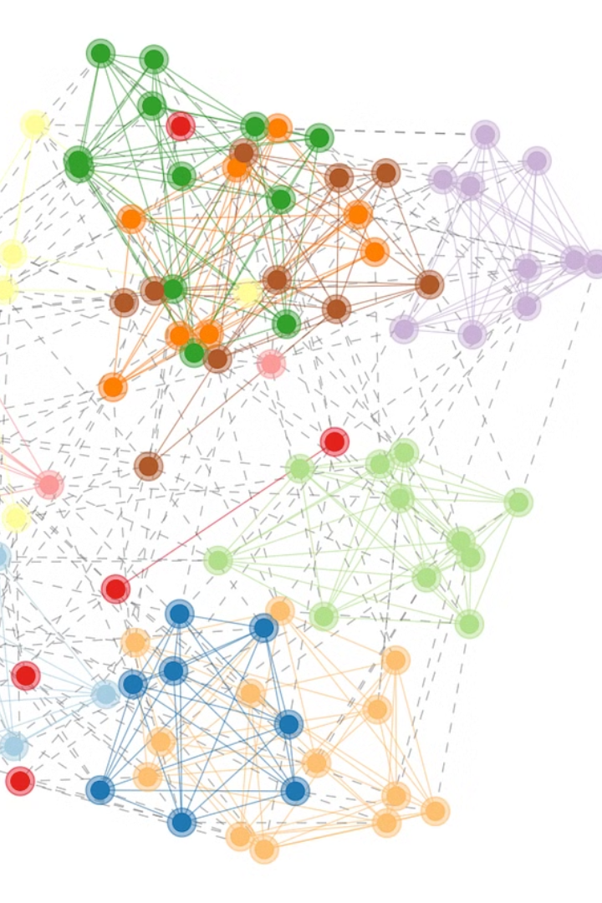
Constructing Independent Spanning Trees
Parallel Algorithm and Scalable Strategy with MPI + OpenMP + METIS Hybrid Parallelization.
by 22i-0919, 22i-0913

Slide 2
Introduction
1
Problem Statement
2
Bubble-Sort Networks
Need for fault-tolerant and secure communication in networks.
Cayley graphs with rich structure suitable for large-scale networks.
3
Applications
Fault tolerance, secure message distribution, load balancing.

Slide 3
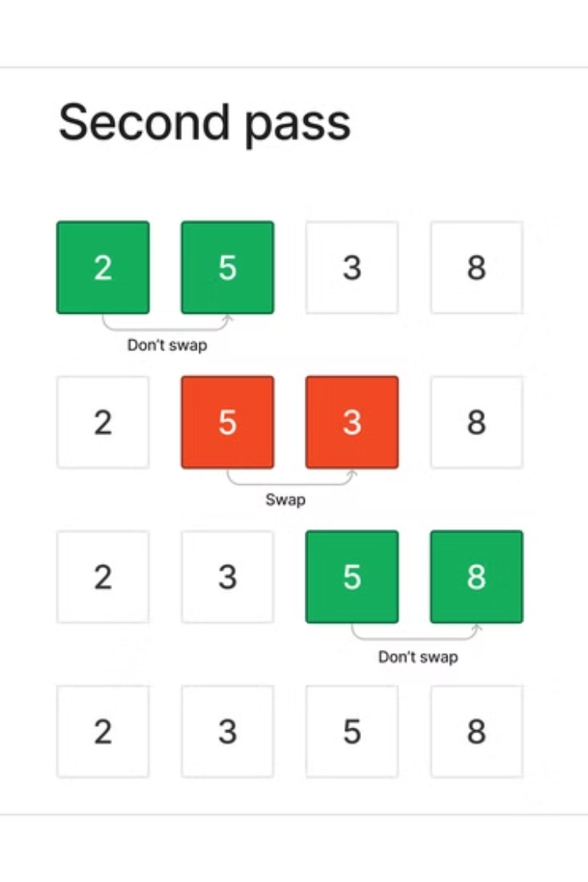
Bubble-Sort Network B_n
Vertices
Edges
All permutations of n elements → n! nodes.
Swap adjacent elements → v is connected to v.
Properties
Vertex-transitive, Diameter: n(n-1)/2, Connectivity: n-1.

Slide 4
Prior Work & Limitations
Kao et al. (2019)
Limitation
Recursive algorithm for constructing n-1 ISTs in B_n.
Recursive → hard to parallelize.
Optimal in amortized complexity.
No parallel construction approach existed.

Slide 5



Key Contributions
Non-recursive Algorithm
Fully Parallelizable
Optimal Time Complexity
Constant time parent computation per vertex. Asymptotically optimal. Proved via exhaustive rule-based path structure.

Slide 6
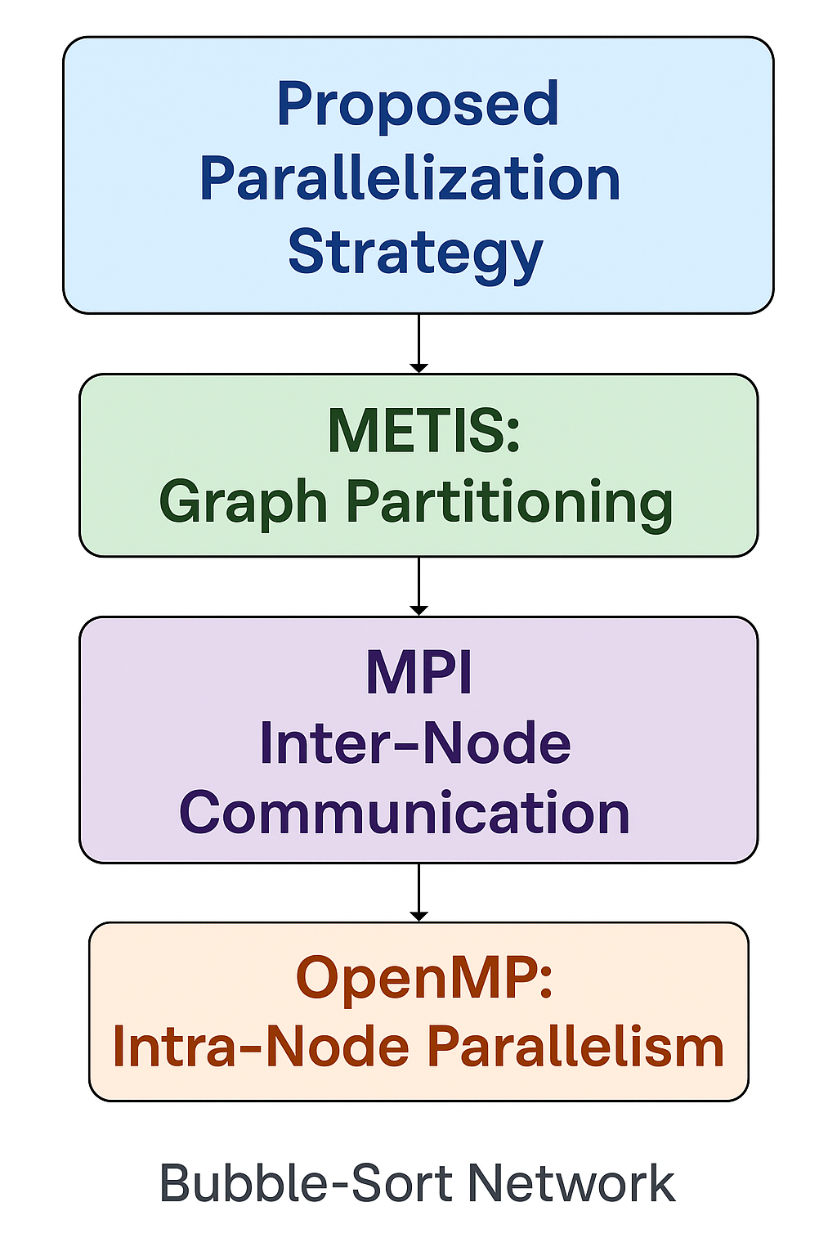


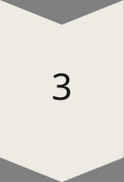
Proposed Algorithm
Inputs
Vertex v, tree index t, dimension n.
Strategy
Determine parent based on local rules.
Key Insight
Parent can be computed independently and in constant time.

Slide 7



Example on B4
Parents
Algorithm determines parents for 3 trees rooted at 1234.
Nodes
Reference
1234, 2134, 1324, etc.
Table 1 and Fig. 3 from the paper.
2
1
3

Slide 8
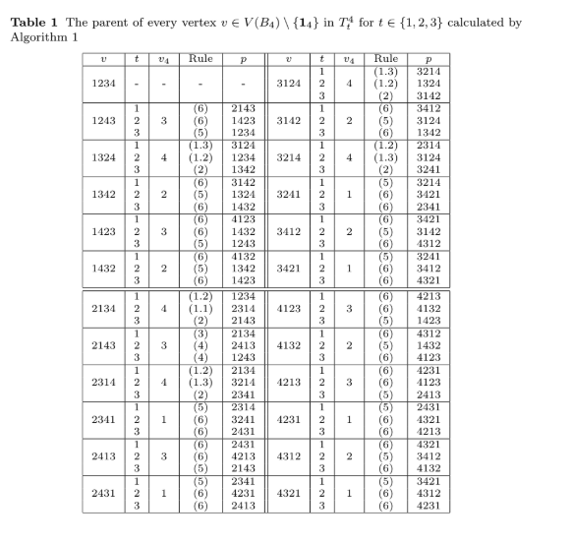
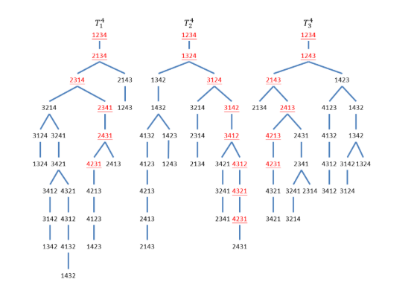

Slide 9
Step-by-Step Strategy
METIS: Partitioning
1
Partition Bn into P balanced subgraphs.
MPI: Inter-Node
2
Tree root distribution, boundary node parent resolution.
OpenMP: Intra-Node
3
Each vertex handled by a thread.
Scalable across clusters and multicore systems. Parallel at vertex level.

Slide 10
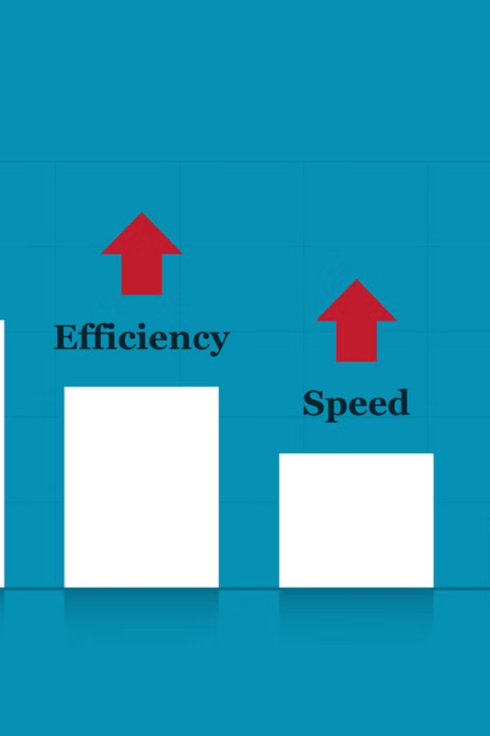
Performance Expectations
Even
Linear
Load Balance
Parallel Speedup
METIS ensures even distribution.
Nearly linear up to the number of partitions.
Efficient
Memory Efficiency
Each node processes only its partition.

Slide 11

Impact of Parallel Strategy
Metric
Benefit
Computation Speed
Fast due to per-vertex independence
Scalability
Linear growth with cores and nodes
Communication Overhead
Minimized using METIS partitioning
Load Balance
Achieved via graph partitioning techniques

Slide 12

Conclusion
Presented a non-recursive, parallel algorithm for ISTs in B_n.
Hybrid parallel strategy ensures full scalability and fast local computation.
This strategy demonstrates how classic graph problems can be scaled to modern HPC environments.

